Slide 1
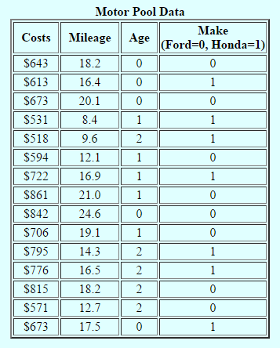
The Gotham City Motor Pool
Gotham City maintains a fleet of automobiles in a special motor pool. These cars are used by the various city agencies when special needs arise for temporary use by personnel who do not have their own assigned automobiles.
The manager of the pool is trying to determine what elements contribute to the maintenance and repair costs of the cars under his care. He surmises that components such as the mileage driven during a year, the age of the car, and possibly even the make of the car might help explain why annual maintenance and repair costs vary. Accordingly, he collects data on these variables for fifteen cars selected at random from the cars in the pool.
“Costs” refers to total maintenance and repair expenses for a car over the past 12 months.
“Mileage” is thousands (000s) of miles driven over the past 12 months.
“Age” is the car’s age (in years) at the beginning of the past 12 months.
Conveniently, all of the cars in the fleet are either Fords or Hondas; this is encoded as “Make” = 0 for Fords, and “Make” = 1 for Hondas.

Slide 2
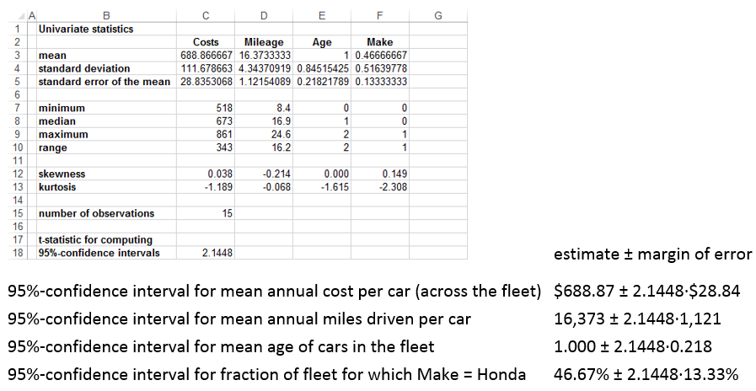
Looking at One Variable at a Time …

Slide 3
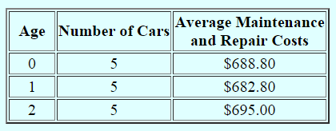
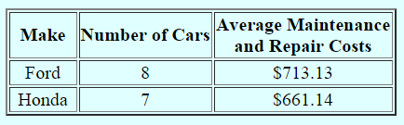
(Two-Dimensional) Tables
As a first step in his analysis of these data, the manager calculates the average maintenance and repair costs for new, one-year-old, and two-year-old cars. The results are:
Although he is somewhat surprised by the results, the manager concludes that the age of the car does not significantly influence the repair and maintenance costs.
As a next step, the manager calculates the average costs for each make of car. The results are:
He concludes that he should, in the future, give preference to purchasing Hondas since he would save $52 each per year in maintenance and repairs.
Do you agree with the manager? How would you suggest that he analyze the data? What are your conclusions?

Slide 4
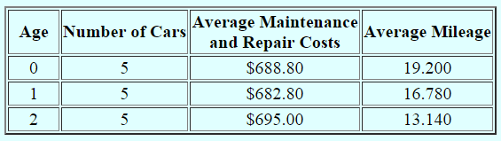
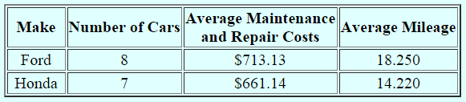
(Two-Dimensional) Tables Show Only Shadows
Not surprisingly, the new cars are more popular with city employees, and get taken out more often (and consequently are driven further) than the older cars during the year.
And, for whatever reason, the Fords are more popular, and end up being driven further than the Hondas during the year.
We need a way to look at all the dimensions of a relationship at the same time. This is what regression analysis can do!
For example, we’ll see (via regression) that Fords of the same age, and driven the same distance, as Hondas have maintenance and repair costs, on average, $47 less per year.

Slide 5
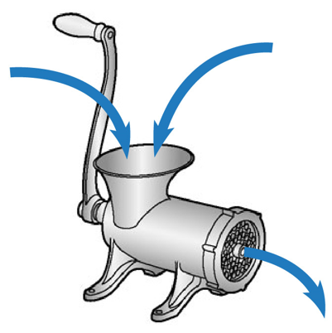
The Regression “Machine”
The regression model (terminology, structure, and assumptions)
relevant sample data
(no missing data)
regression results
(today’s focus)

Slide 6
The Regression Model
the dependent variable
explanatory variables
residual term
or
independent variables
coefficients
linear
mathematical structure
What we’re talking about is sometimes explicitly called “linear regression analysis,” since it assumes that the underlying relationship is linear (i.e., a straight line in two dimensions, a plane in three, and so on)!

Slide 7
Why Spend All This Time on Such a Limited Tool?
Some interesting relationships are linear.
All relationship are locally linear!
Several of the most commonly encountered nonlinear relationships in management can be translated into linear relationships, studied using regression analysis, and the results then untranslated back to the original problem!

Slide 8
A Few Final Assumptions Concerning ε
The validity of regression analysis depends on several assumptions concerning the residual term.
  E[ε] = 0 . This is purely a cosmetic assumption. The estimate of α will include any on-average residual effects which are different from zero.
  ε varies normally across the population. While a substantive assumption, this is typically true, due to the Central Limit Theorem, since the residual term is the total of a myriad of other, unidentified explanatory variables. If this assumption is not correct, all statements regarding confidence intervals for individual predictions might be invalid.
The following additional assumptions will be discussed later in the course.
  StdDev[ε] does not vary with the values of the explanatory variables. (This is called the homoskedasticity assumption.) Again, if this assumption is not correct, all statements regarding confidence intervals for individual predictions might be invalid.
  ε is uncorrelated with the explanatory variables of the model. The regression analysis will “attribute” as much of the variation in the dependent variable as it can to the explanatory variables. If some unidentified factor covaries with one of the explanatory variables, the estimate of that explanatory variable’s coefficient (i.e., the estimate of its effect in the relationship) will suffer from “specification bias,” since the explanatory variable will have both its own effect, and some of the effect of the unidentified variable, attributed to it. This is why, when doing a regression for the purpose of estimating the effect of some explanatory variable on the dependent variable, we try to work with the most “complete” model possible.

Slide 9
What Can Regression Analysis Do for You?
Make predictions (based on available information)
Estimate group means (for similar individuals)
Measure effects (while controlling for other influences)
Help evaluate/improve a model (of a relationship)

Slide 10
1. Make a Prediction
For an individual, predict the value of the dependent variable, given the values of some of the explanatory variables.
Process: “Regress” the dependent variable onto the given explanatory variables. Then “Predict.” Fill in the values of the explanatory variables. Hit the “Predict” button.
Answer: (prediction) ± (~2)·(standard error of prediction)
Example: Predict the maintenance cost of a one-year-old car (in the fleet) which will be driven 18,500 miles over the next year.

Slide 11
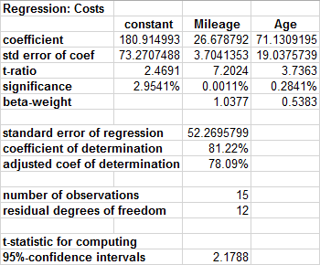
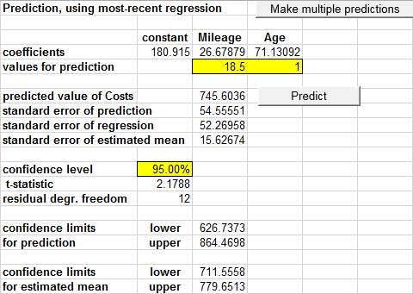
Make a Prediction
Predict the annual maintenance cost of a one-year-old car (in the fleet) which will be driven 18,500 miles over the next year.
Process: “Regress” Cost onto Mileage and Age. Then “Predict”, filling in 18.5 for Mileage and 1 for Age. Hit the “Predict” button.
  (prediction) ± (~2)·(standard error of prediction)
  $745.60 ± 2.1788·$54.56 (we’re 95%-confident that the prediction is within ±$118.88 of actual Costs, i.e., actual Costs end up somewhere between $626.74 and $864.47)

Slide 12
2. Estimate a Group Mean
For a group of similar individuals (i.e., individuals with the same values for several independent variables), estimate the mean value of the dependent variable.
Process: “Regress” the dependent variable onto the given explanatory variables. Then “Predict.” Fill in the values of the explanatory variables. Hit the “Predict” button.
Answer: (prediction) ± (~2)·(standard error of estimated mean)
Example: Estimate the mean annual maintenance cost of two-year-old Fords (note the plural!) in the fleet.

Slide 13
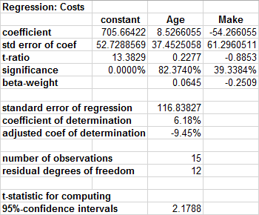
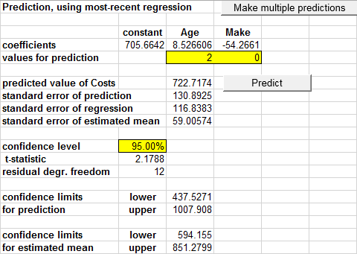
Estimate a Group Mean
Estimate the mean annual maintenance cost of two-year-old Fords (note the plural!) in the fleet.
Process: “Regress” Cost onto Age and Make. Then “Predict”, filling in 2 for Age and 0 for Make. Hit the “Predict” button.
  (prediction) ± (~2)·(standard error of estimated mean)
  $722.72 ± 2.1788·$59.01

Slide 14
Sources of Prediction-Related Error
(a two-slide technical digression)
There are two ways in which our prediction (Y_{pred}) for an individual might differ from reality (Y):
reality
the prediction equation
standard error of the prediction
standard error of the estimated mean
standard error of the regression, StdDev(ε)

Slide 15
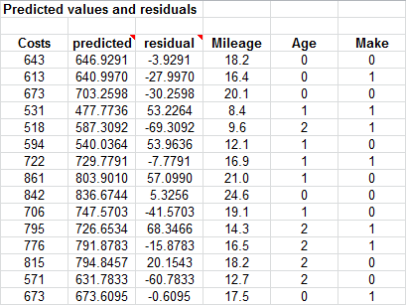
The Standard Error of the Regression
Using the prediction equation, we predict for each sample observation.
The difference between the prediction and the actual value of the dependent variable (i.e., the error) is an estimate of that individual’s residual.
StdDev(ε) is estimated from these.
Indeed, the regression “process” simply finds the coefficient estimates which minimize the standard error of the regression (or equivalently, which minimize the sum of the squared residuals)!

Slide 16
3. Measure a Pure Effect
A one-unit difference in an explanatory variable, when everything else of relevance remains the same, is typically associated with how large a difference in the dependent variable?
Process: “Regress” the dependent variable onto all of the relevant explanatory variables (i.e., use the “most complete” model available).
Answer: (coefficient of explanatory variable)
± (~2)·(standard error of coefficient)
Example: Estimate the “pure” impact of 1,000 miles of driving during the year on annual maintenance costs.

Slide 17
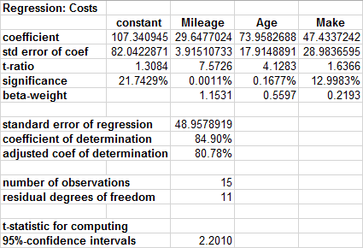
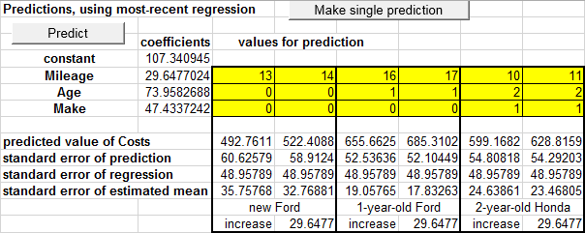
Measure a Pure Effect
Estimate the “pure” impact of 1,000 miles of driving during the year on annual maintenance costs.
Process: “Regress” Costs onto Mileage, Age, and Make (i.e., use the “most complete” model available, so Age and Make can be held constant).
  (coefficient of explanatory variable) ± (~2)·(standard error of coefficient)
  $29.65 ± 2.2010·$3.92

Slide 18
4. Modelling: Why Does The Dependent Variable Vary?
What fraction of the variance in the dependent variable (from one individual to another) can potentially be explained by the fact that the explanatory variables in our model vary (from one individual to another)?
Process: “Regress” the dependent variable onto the explanatory variables currently under consideration. Then look at the “adjusted coefficient of determination” (synonymously, “the adjusted r-squared”).
Example: Why does annual maintenance expense vary across the cars in the fleet?

Slide 19
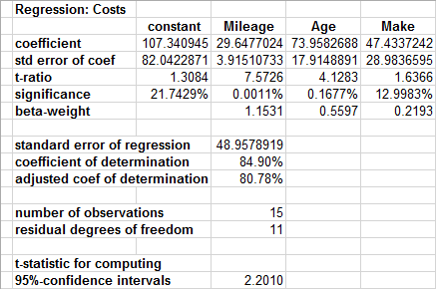
Why Does The Dependent Variable Vary?
Why does annual maintenance expense vary across the cars in the fleet?
Partial Answer: Because Mileage, Age, and Make vary across the fleet.
How much of an answer is that? Regress Costs onto those three variables.
Variation in Mileage, Age, and Make can potentially explain 80.78% of the variation in Costs. The other 19.22% of the variation must be explained by other unidentified variables still lumped together in the residual term.

Slide 20
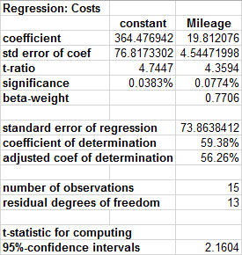
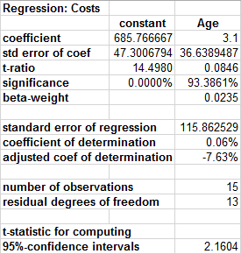
Why Does The Dependent Variable Vary?
Why does annual maintenance expense vary across the cars in the fleet?
  Variation in Mileage alone can explain 56.26% of the variation in Costs.
  Variation in Age alone can explain nothing (read “0%” for negative values*).
  Variation in the two together can explain 78.09% of the variation in Costs.

Slide 21
The Explanatory Power of the Model
Names can vary: The {adjusted, corrected, unbiased} {coefficient of determination, r-squared} all refer to the same thing.
  Without an adjective, the {coefficient of determination, r-squared} refers to a number slightly larger than the “correct” number, and is a throwback to pre-computer days.
When a new variable is added to a model, which actually contributes nothing to the model (i.e., its true coefficient is 0), the adjusted coefficient of determination will, on average, remain unchanged.
  Depending on chance, it might go up or down a bit.
  *If negative, interpret it as 0%.
  The thing without the adjective will always go up. That’s obviously not quite “right.”

Slide 22
Modelling: Relative Explanatory Importance
Considering a set of explanatory variables, rank them in order of importance in helping to explain why the dependent variable varies.
Process: “Regress” the dependent variable onto the target set of explanatory variables. Rank the variables in order of the absolute values of their beta-weights, from largest (most important in explaining variation in the dependent variable) to smallest (least important in explaining variation.
Example: Rank Mileage, Age, and Make in order of relative importance in helping to explain why Costs vary across the fleet.

Slide 23
5. Modelling: Relative Explanatory Importance
Rank Mileage, Age, and Make in order of relative importance in helping to explain why Costs vary across the fleet.
  One standard-deviation’s-worth of variation in Mileage is associated with 1.1531 standard-deviation’s-worth of variation in Costs.
  One standard-deviation’s-worth of variation in Age is associated with 0.5567 standard-deviation’s-worth of variation in Costs.
  One standard-deviation’s-worth of variation in Make is associated with 0.2193 standard-deviation’s-worth of variation in Costs.
  Therefore, variation in Mileage is more than twice as important as is variation in Age (and more than five times as important as is the fact that some cars in the fleet are Fords, and others are Hondas) in helping to explain why Costs vary (when all three of those variables are considered together).

Slide 24
The Beta-Weights
You can’t compare regression coefficients directly, since they may carry different dimensions.
The beta-weights are dimensionless, and combine how much each explanatory variable varies, with how much that variability leads to variability in the dependent variable.
  Specifically, they are the product of each explanatory variable’s standard deviation (how much it varies) and its coefficient (how much its variation affects the dependent variable), divided by the standard deviation of the dependent variable (just to remove all dimensionality).

Slide 25
End of Session 1

Slide 26
6. Modelling: Which Variables “Belong” in the (Current) Model?
How strong is the evidence that each explanatory variable has a non-zero coefficient (i.e., plays a predictive role) in the current model?
Process: “Regress” the dependent variable onto the (current) set of explanatory variables. For each explanatory variable, examine the “significance level” (synonymously, the “p-value”) of the sample data with respect to the null hypothesis that the true coefficient of that variable is zero.
  The closer the significance level is to 0%, the stronger is the evidence against that null hypothesis (i.e., the stronger is the evidence that this variable does indeed belong in the current model).
Example: How strong is the evidence that Mileage, Age, and Make each “belong” in the model which predicts Costs from all three?

Slide 27
Which Variables “Belong” in the (Current) Model?
How strong is the evidence that Mileage, Age, and Make each “belong” in the model which predicts Costs from all three?
  For Mileage and Age, “overwhelmingly strong”.
  For Make, a “little bit of supporting evidence”, but not even “moderately strong”.
  With more data, if the true coefficient of Make is non-zero, the significance level will move towards 0%, and the evidence for inclusion will be stronger.
  With more data, if the true coefficient of Make is really zero, the significance level will stay well above 0%, and the estimate of the coefficient will move towards 0 (the “truth”).

Slide 28
Modelling: Detection of Modelling Issues
Is a linear model appropriate?
Judgment (non-statistical)
Residual analysis (non-statistical)
Residual plots
  Against explanatory variables
  Against predicted values
Outlier analysis

Slide 29
Modelling: What is the Structure of the Relationship?
Is a linear model appropriate? Are there alternatives?
Interactions
Other nonlinearities
  Quadratic
  Logarithmic – post-course
    In explanatory variables
    In the dependent variable
Qualitative variables
  Explanatory
  Dependent – post-course

